Slide 1
Project Title: Financial Analytics Name: Shrinivas Pattar Date: 20-07-2024

Slide 2
Introduction
The financial sector is one of the most critical components of the global economy, influencing investment decisions, economic policies, and corporate strategies. Financial analytics involves the use of data analysis techniques to understand and interpret financial data, which can help businesses make informed decisions, identify market trends, and improve their financial performance.
In this project, we focus on analyzing the financial data of the top 500 companies in India. Our goal is to provide insights into market capitalization and quarterly sales, which are crucial metrics for assessing the financial health and market position of these companies. By analyzing this data, we aim to uncover patterns and relationships that can help businesses understand their competitive landscape and make strategic decisions.

Slide 3
Objectives and Scope of the Analysis
Objectives:
1. To analyze the market capitalization and quarterly sales of the top 500 companies in India.
2. To identify key metrics and relationships between different financial attributes.
3. To perform advanced analytics, including regression analysis, to predict quarterly sales based on market capitalization.
4. To create interactive visualizations that allow stakeholders to explore the data dynamically.
Scope:
The scope of this analysis includes:
1. Cleaning and preprocessing the provided dataset to ensure data quality.
2. Performing descriptive statistical analysis to summarize the key metrics.
3. Visualizing the data through scatter plots, histograms, and correlation heatmaps.
4. Conducting regression analysis to identify predictive relationships.
5. Developing interactive visualizations using Plotly for better data exploration.
6. Generating a comprehensive report that summarizes the findings and provides actionable insights.

Slide 4
Data Description
The dataset contains financial information of the top 500 companies in India. This dataset is used to analyze market capitalization and quarterly sales to uncover patterns and relationships.
S.No.: Serial number of the company
Name: Name of the company.
Mar Cap - Crore: Market capitalization in crores.
Sales Qtr - Crore: Quarterly sales in crores.
Sample Table

Slide 5
Dataset Information and Missing Values
Dataset Information: This dataset contains financial information of the top 500 companies in India. The table below shows the structure of the dataset, including the number of entries and data types.
Missing Values Summary: Understanding the extent of missing values helps in assessing the quality of the dataset and planning data cleaning steps. The table below summarizes the missing values for each column.
Column | Missing Values
S.No. | 0
Name | 0
Mar Cap - Crore | 9
Sales Qtr - Crore | 123
Unnamed: 4 | 394

Slide 6
Descriptive Statistics
Descriptive statistics provide a summary of the central tendency, dispersion, and shape of the distribution of the dataset's attributes.
Attribute | Count | Mean | Std Dev | Min | Q1 | Median | Q3 | Max
Mar Cap - Crore | 365 | 31300.97 | 67224.64 | 3017.07 | 5089.87 | 9097.33 | 21372.18 | 583436.7
Sales Qtr - Crore | 365 | 4395.98 | 11092.21 | 47.24 | 593.74 | 1278.3 | 2840.75 | 110666.9

Slide 7
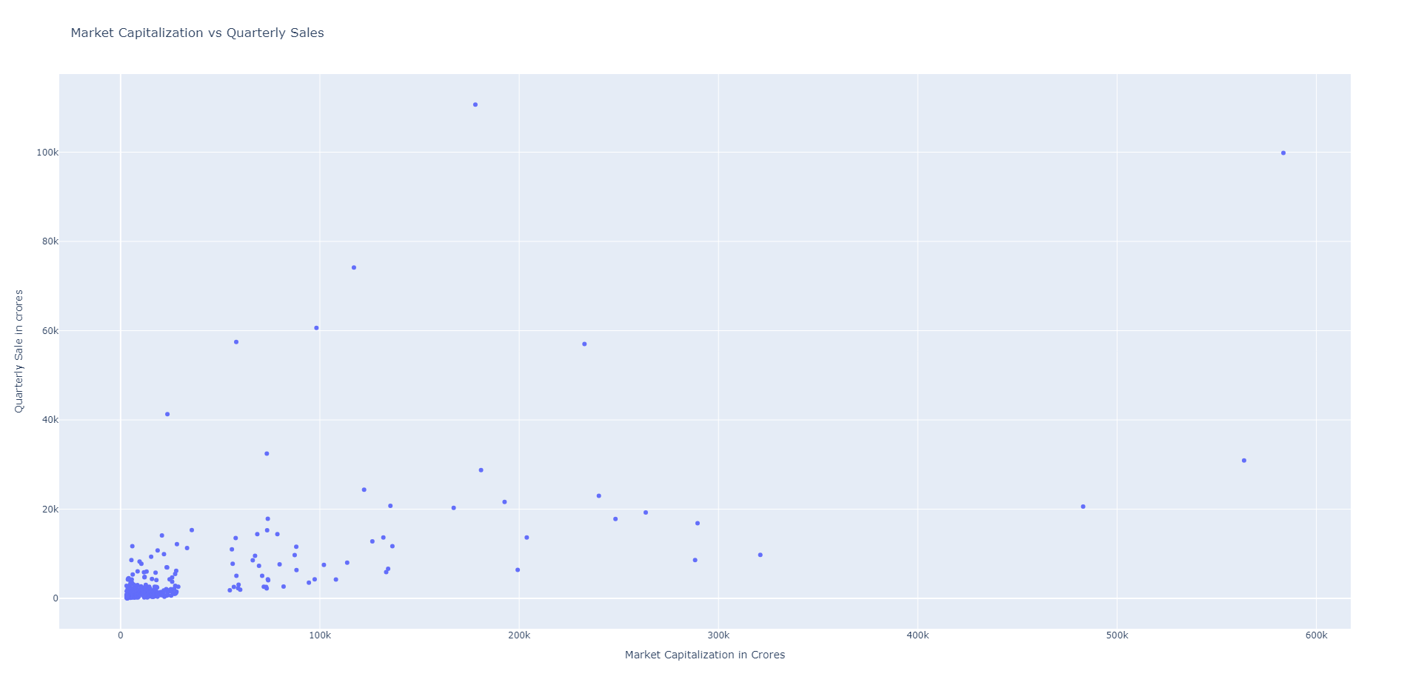
Scatter Plot: Market Capitalization vs. Quarterly Sales

Slide 8
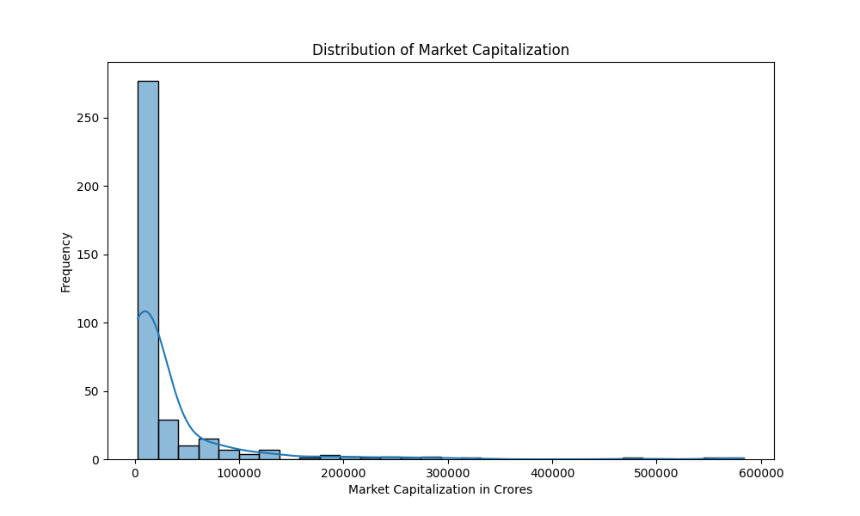
Histogram: Distribution of Market Capitalization

Slide 9
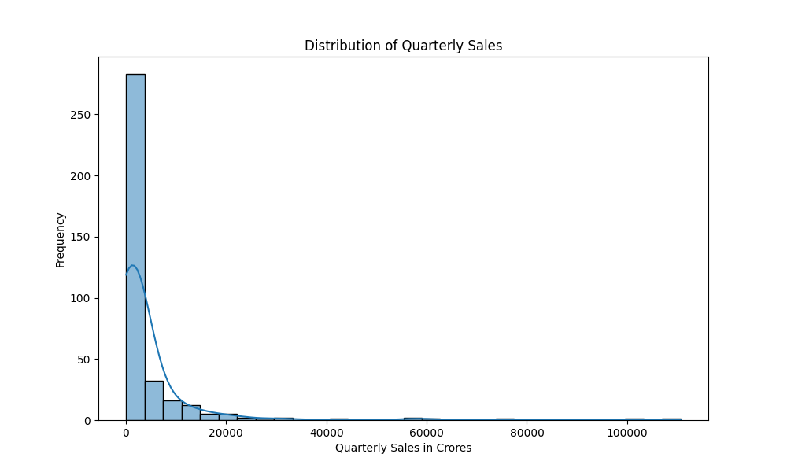
Histogram: Distribution of Quarterly Sales

Slide 10
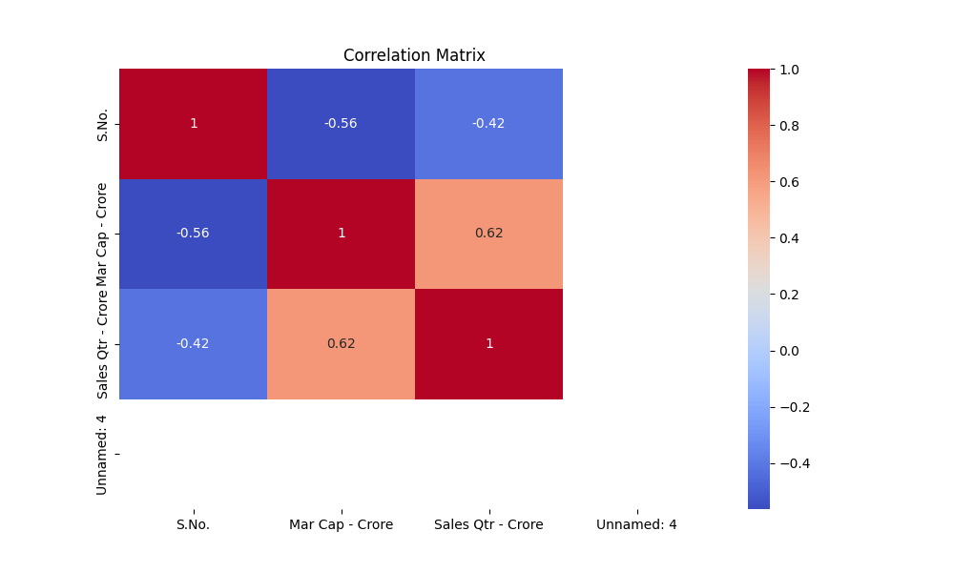
Correlation Heatmap

Slide 11
Advanced Analytics
Introduction to Regression Analysis:
Explanation of what regression analysis is.
Purpose of using regression analysis in this project.
Key Metrics:
Mean Squared Error (MSE)
R-squared (R²) score
Regression Plot:
Visual representation of the regression model.
Interpretation of the plot.

Slide 12
Introduction to Regression Analysis
What is Regression Analysis?
Regression analysis is a statistical method used to examine the relationship between two or more variables. It helps in predicting the value of a dependent variable based on the value of one or more independent variables.
Purpose in this Project: To predict quarterly sales based on market capitalization of the top 500 companies in India. To understand the strength and nature of the relationship between these two financial metrics.

Slide 13
Key Metrics
Mean Squared Error (MSE): MSE measures the average of the squares of the errors or deviations, i.e., the difference between actual and predicted values. Lower MSE indicates a better fit.
R-squared (R″) Score: R″ indicates the proportion of the variance in the dependent variable that is predictable from the independent variable. Ranges from 0 to 1, with higher values indicating a better fit.

Slide 14
Regression Analysis Results
Calculated Metrics: Mean Squared Error (MSE): 66,876,117.34, R-squared (R″) Score: 0.638
Interpretation: The R″ score of 0.638 indicates that 63.8% of the variance in quarterly sales can be explained by market capitalization. This shows a moderate positive relationship. The MSE value of 66,876,117.34 indicates the average squared difference between the actual and predicted quarterly sales values. While the model has a moderate fit, there is room for improvement.

Slide 15
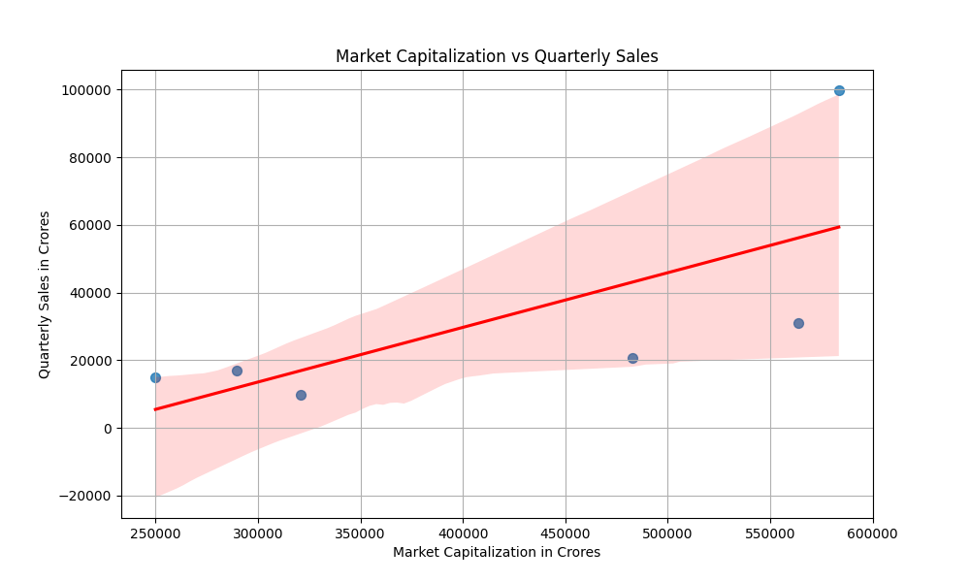
Regression Plot
Regression Plot Explanation: The regression plot shows the relationship between market capitalization and quarterly sales. The blue dots represent the actual data points for different companies. The red line represents the predicted values from the regression model. Interpretation: The regression line's upward slope confirms a positive relationship between market capitalization and sales. Some data points deviate significantly from the regression line, indicating the presence of outliers or other influencing factors.

Slide 16
Conclusion
Summary of Key Findings: Our analysis shows a positive relationship between market capitalization and quarterly sales for the top 500 companies in India. Companies with higher market capitalization tend to have higher quarterly sales. The correlation heatmap reveals a moderate positive correlation (0.62) between these two metrics. Additionally, descriptive statistics indicate significant variability in market capitalization and quarterly sales among the companies.
Business Implications: Understanding the positive relationship between market capitalization and sales can help businesses identify growth opportunities and benchmark their performance against competitors. Companies can leverage this information to enhance their financial strategies and investment decisions. The insights can also guide marketing and operational improvements to boost sales and market value.

